Slide 1
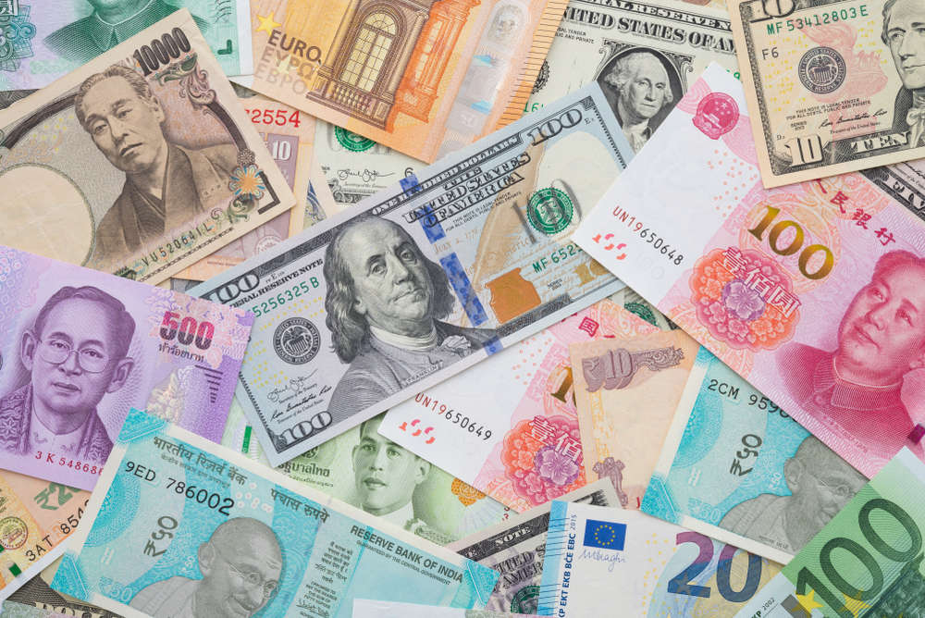
Currency Converter Using Python
Monali Ahire (ET-A-04 )
GR NO. 11810458

Slide 2
Introduction :
A currency converter is software code that is designed to convert one currency into another in order to check its corresponding value
How it works?
Why we need ?
Without proper conversion of currency there is risk to lose money instead of making profit. So ,to make private transactions abroad, then it is most likely that you will need to use a currency converter.
people who go on vacation abroad will also benefit from using currency converters.

Slide 3
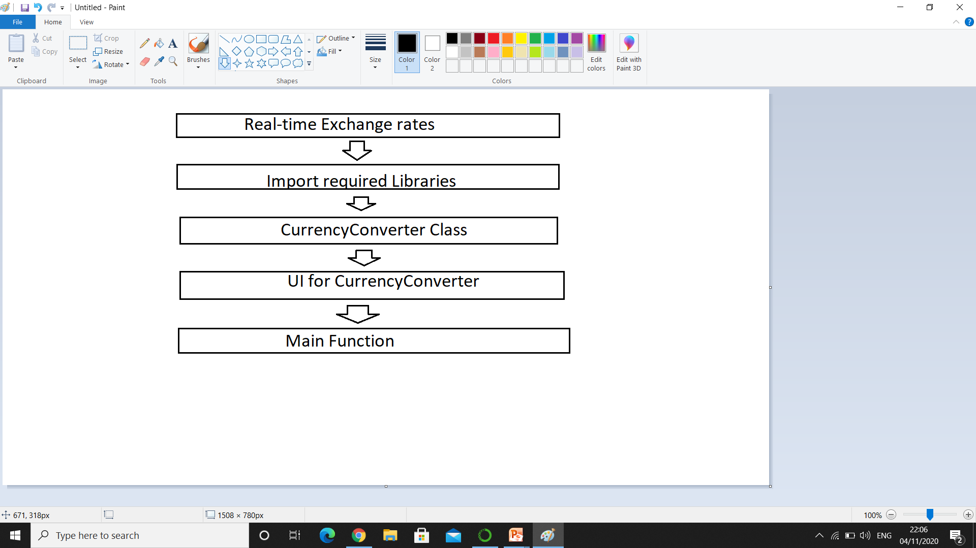
Design of project :
Pygame Libraries

Slide 4
Libraries used :
Tkinter – For User Interface (UI)
Requests – to get url
To get real-time exchange :
https://api.exchangerate-api.com/v4/latest/USD

Slide 5
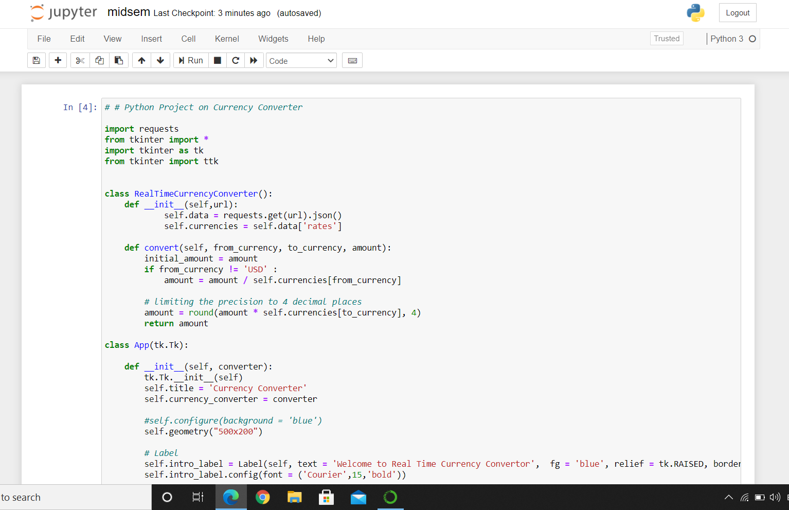
Code :

Slide 6
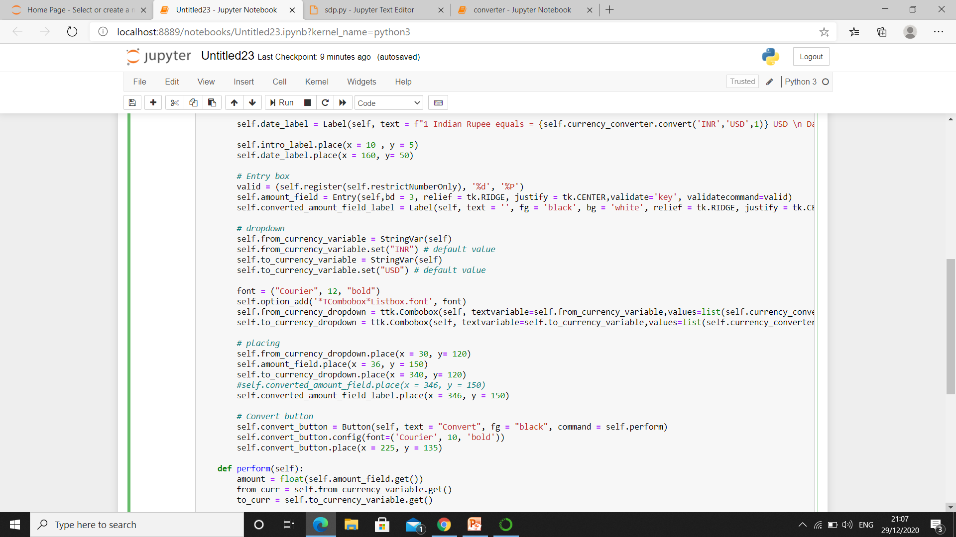

Slide 7
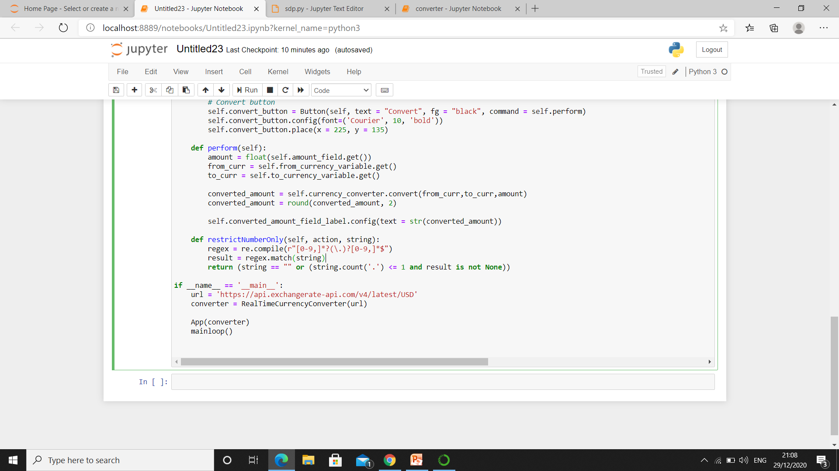

Slide 8
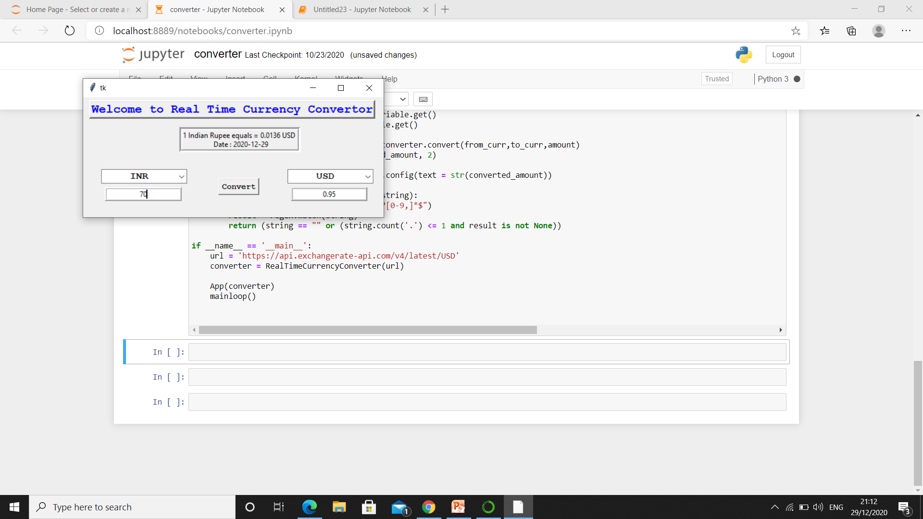
Result :

Slide 9
ADVANTAGES :
Can be Used Anywhere.
It is Easy to Use
Offers Speedy Operations
It is Reliable
It Can Be Used In Import/Export Business

Slide 10
Thank you

